Slide 1
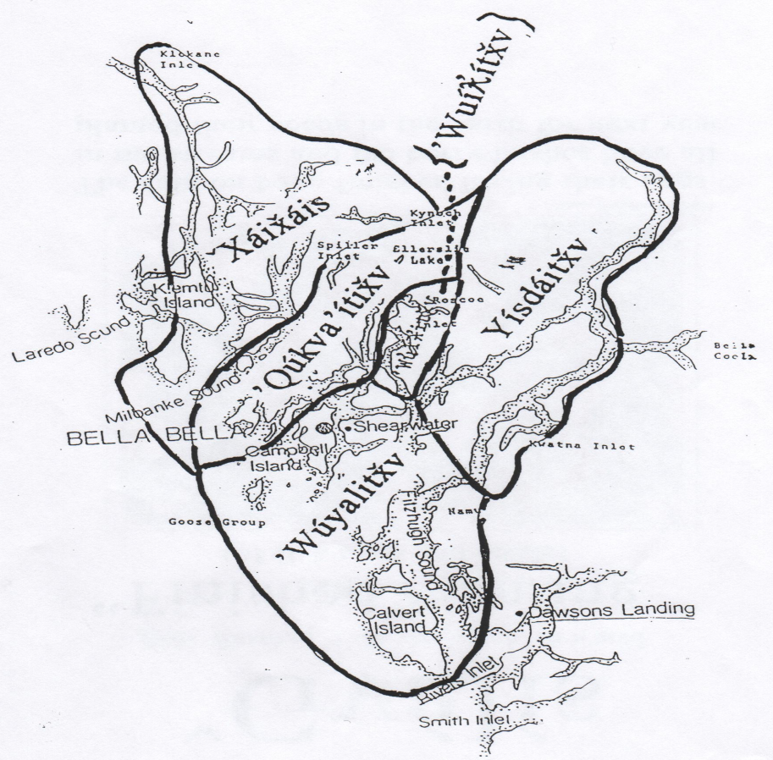

Háiɫzaqv traditional territory is 35553 square kilometers of land and sea extending from the southern tip of Calvert Island, up to Dean Channel and Burke Channels as far as Kimsquit and the head of Dean Channel to the northeast, and up to Mathieson Finlayson Channels to the north. It includes, Roscoe, Cousins and Spiller Inlets, Ellerslie Lake and the outercoast regions of Milbanke Sound, the Goose Island Groups and Calvert Island.

Slide 2
Sk̓áukvnts lílqvlaƛi We are five tribes. ’Wúyalitx̌v The Outside People ’Qvúqvay̓áitx̌v The Calm Water People ’Wuíƛ̓ítx̌v The Inside People ’Yísdáitx̌v People of ’Yísdá X̌áix̌áis Down River or North

Slide 3
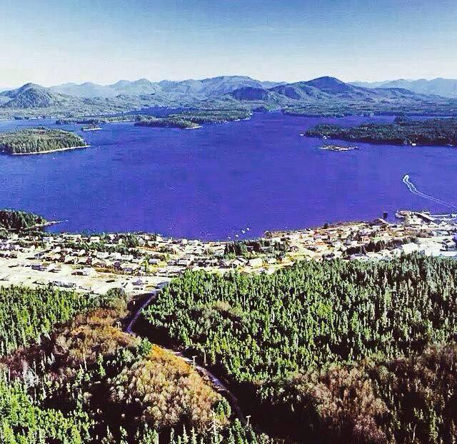
’Wúyalitx̌v -The Outside People

Slide 4
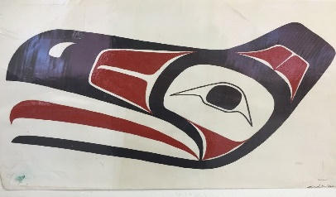
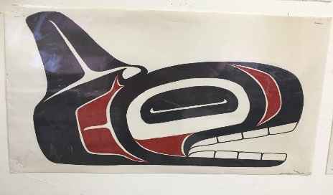
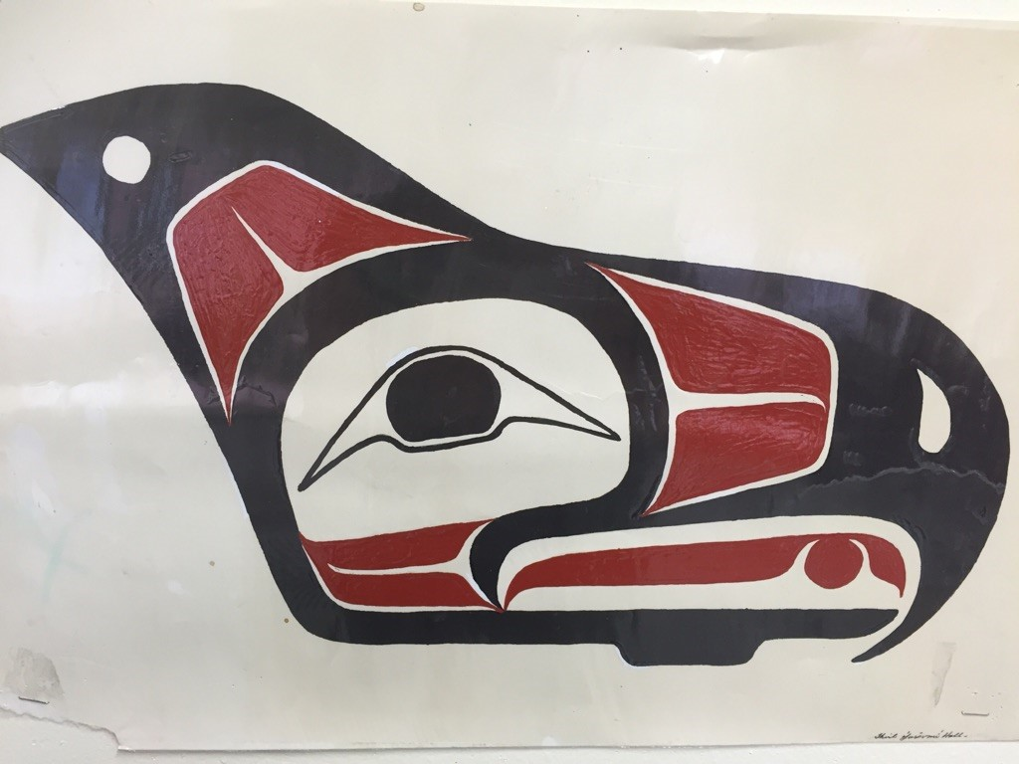
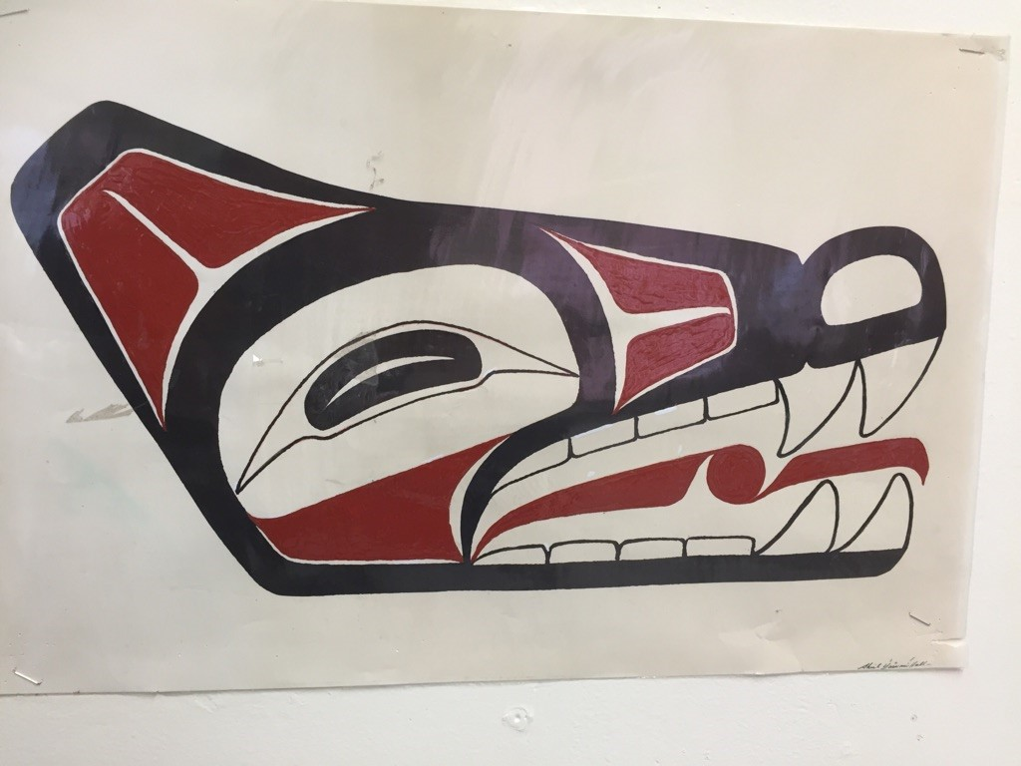
Múkvnts gṃ̓inux̌v
We are four crests.
ÿGvu̓íxdáṇx̌v -Raven Crest
Hḷ́x̌ʔaxdáṇx̌v-Killerwhale Crest
Wík̓vaxdáṇx̌v - Eagle Crest
’Kvsḷc̓áxdáṇx̌v - Wolf Crest

Slide 5
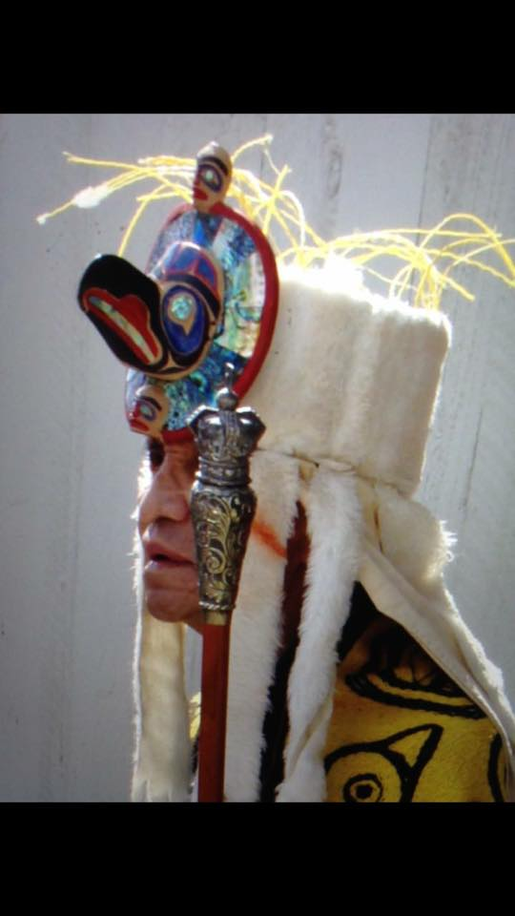
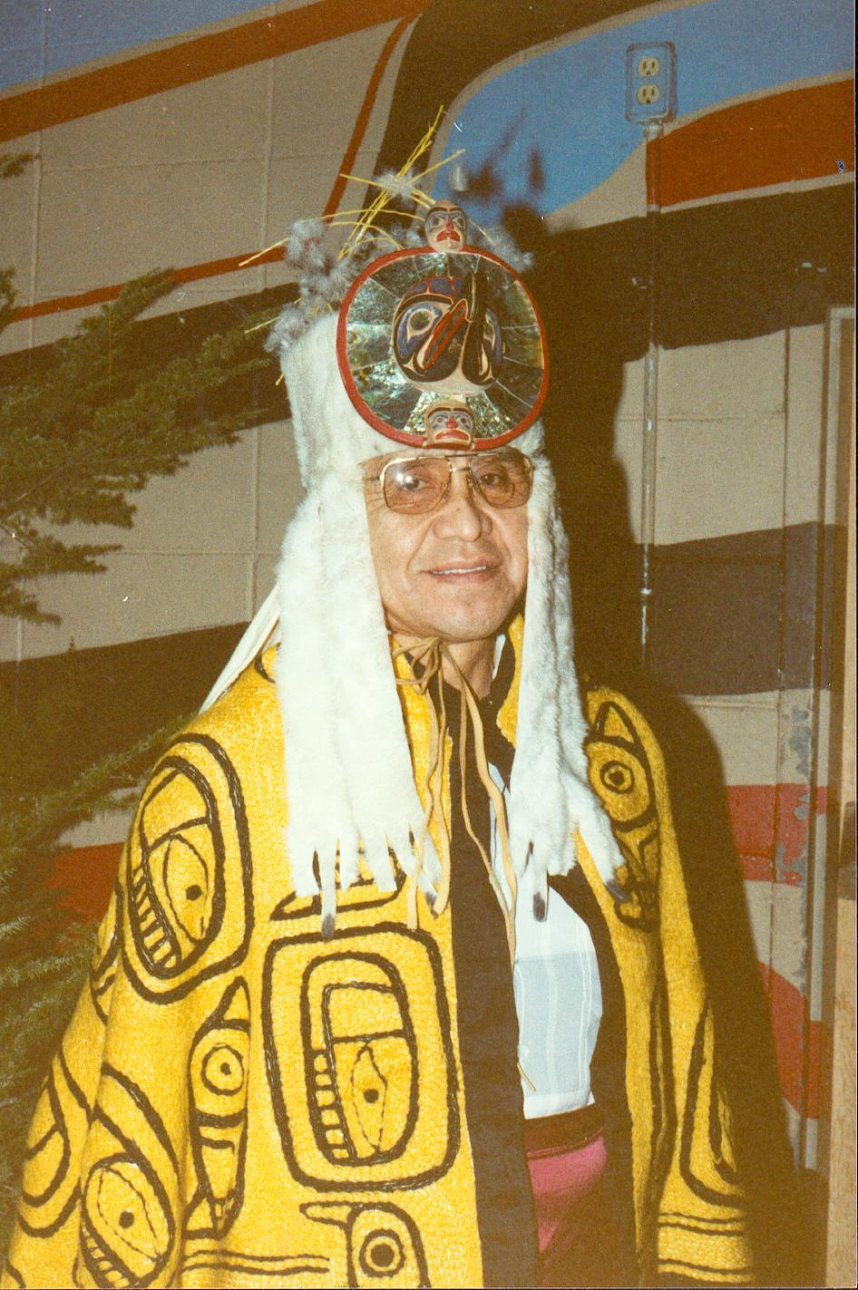
’Hím̓ás Waúyala Translation: Chief - Water flowing out of a house. Reg Moody Humchitt Lílqvlaƛi - ’Wúyalitx̌v

Slide 6
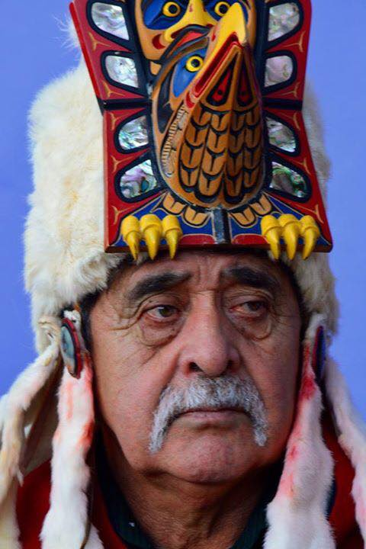
’Hím̓ás Wígviɫba Wákas Translation: Chief - Eagle Nose, Great River Harvey Humchitt Sr. – Lílqvlaƛi - ’Wúyalitx̌v

Slide 7
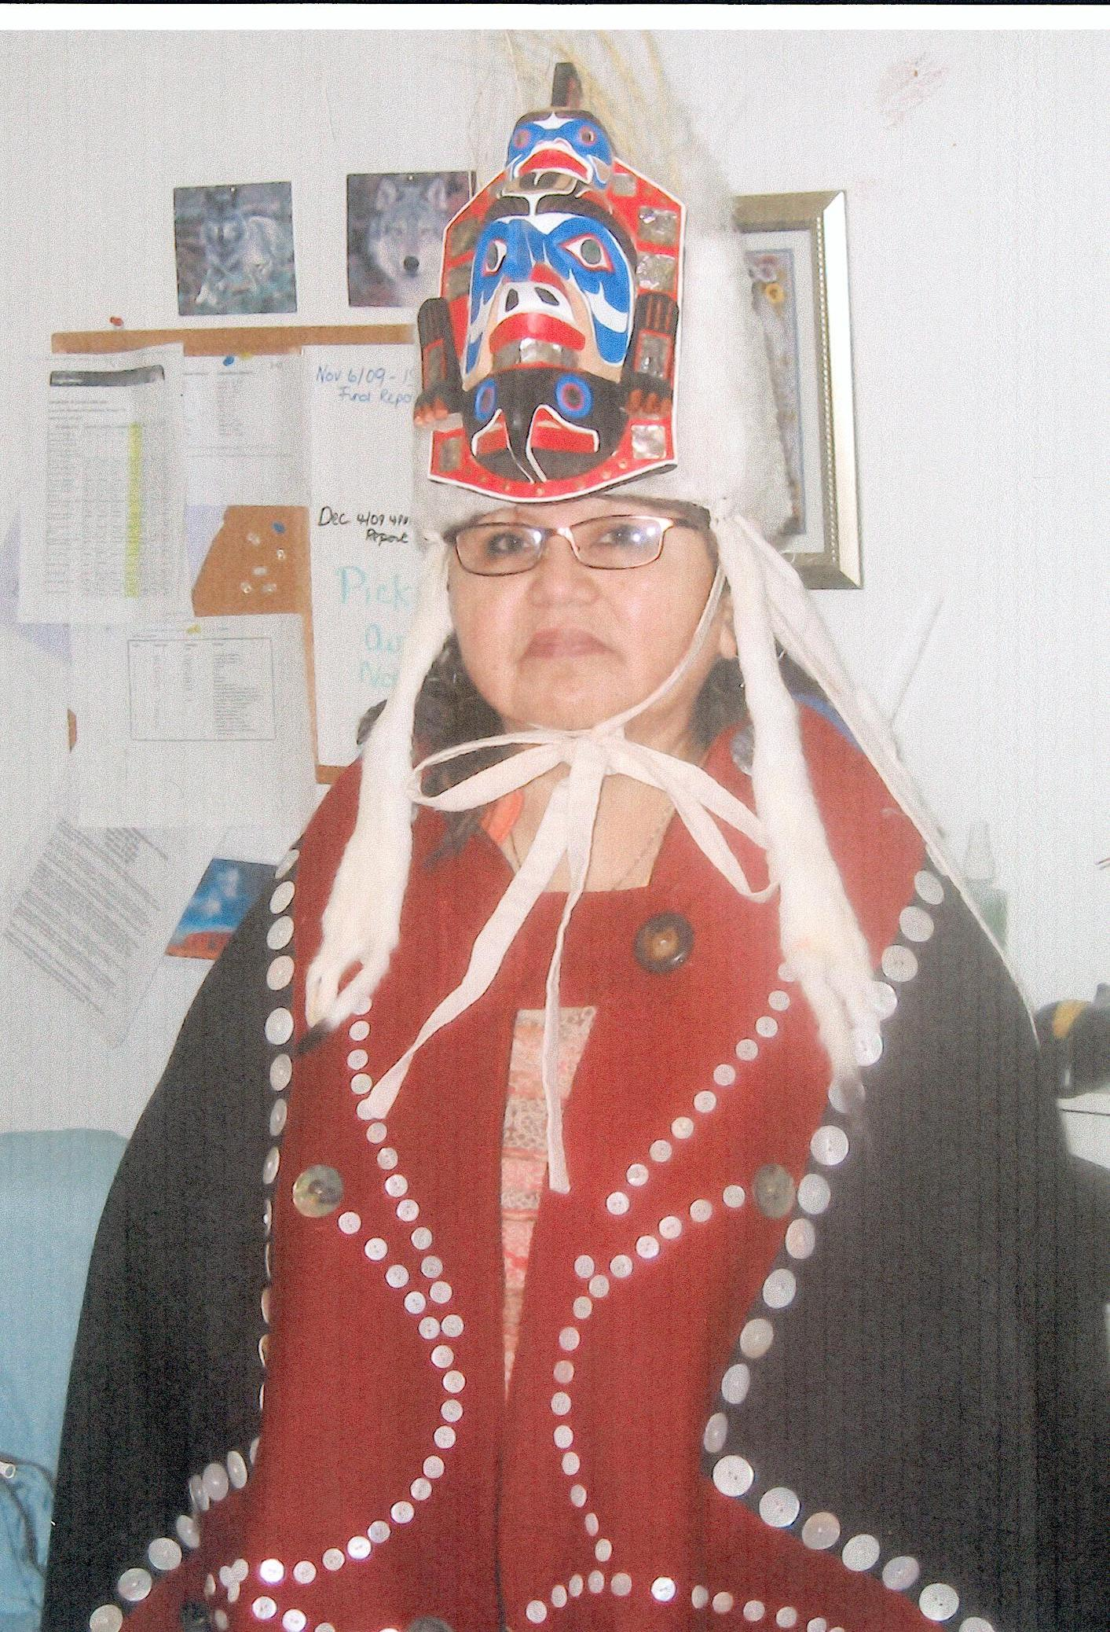
’Hím̓ás ’Gvíut̓izas Translation: Chief - Coming out of the forest. Joanne Green Lílqvlaƛi Nuluwitx̌v

Slide 8
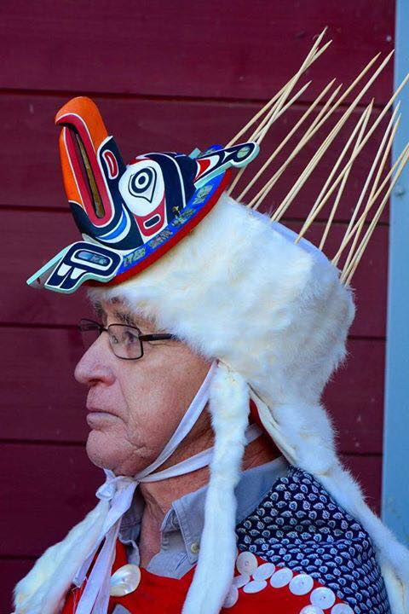
’Hím̓ás ’Qvíɫtákv Translation: Chief - Embraced into Water Chief Earl Newman Sr Lílqvlaƛi - Kvai itx̌v

Slide 9
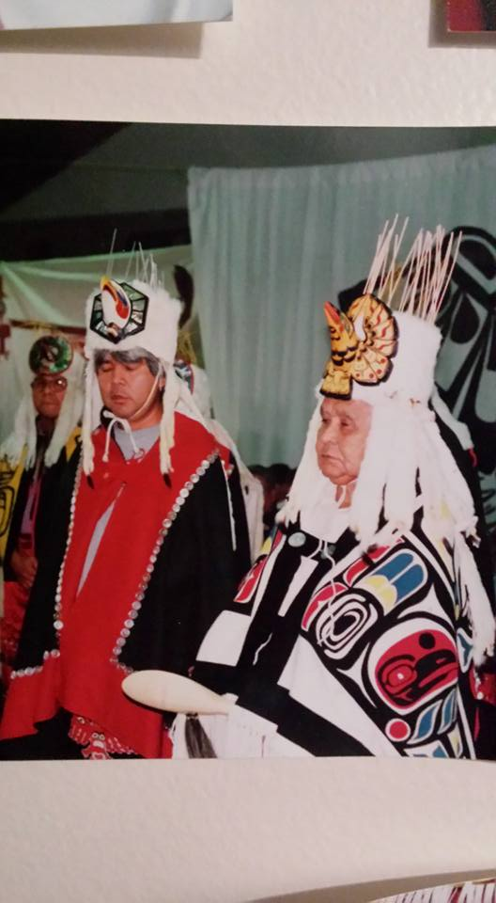
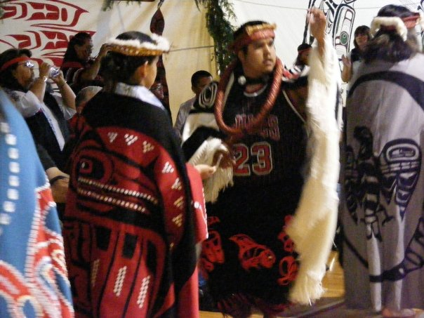
’Hím̓ás Gálúyaǧṃi Translation: Chief - Very first one Lenord Humchitt Lílqvlaƛi - ’Wúyalitx̌v

Slide 10
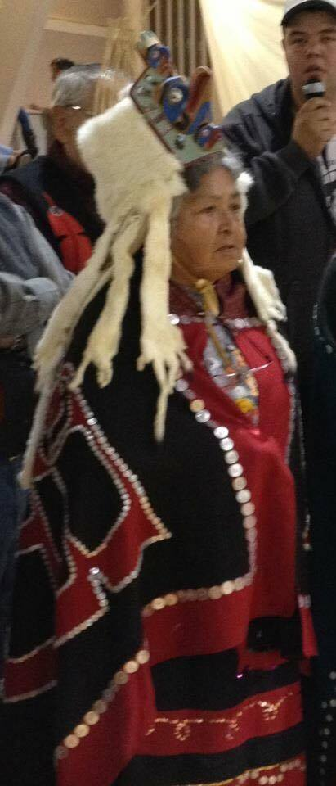
’Hím̓ás ’Yím̓ác̓ix̌sda Translation: Chief - Wanting to be Chief Maryanne Lawson Lílqvlaƛi - ’Wúyalitx̌v

Slide 11
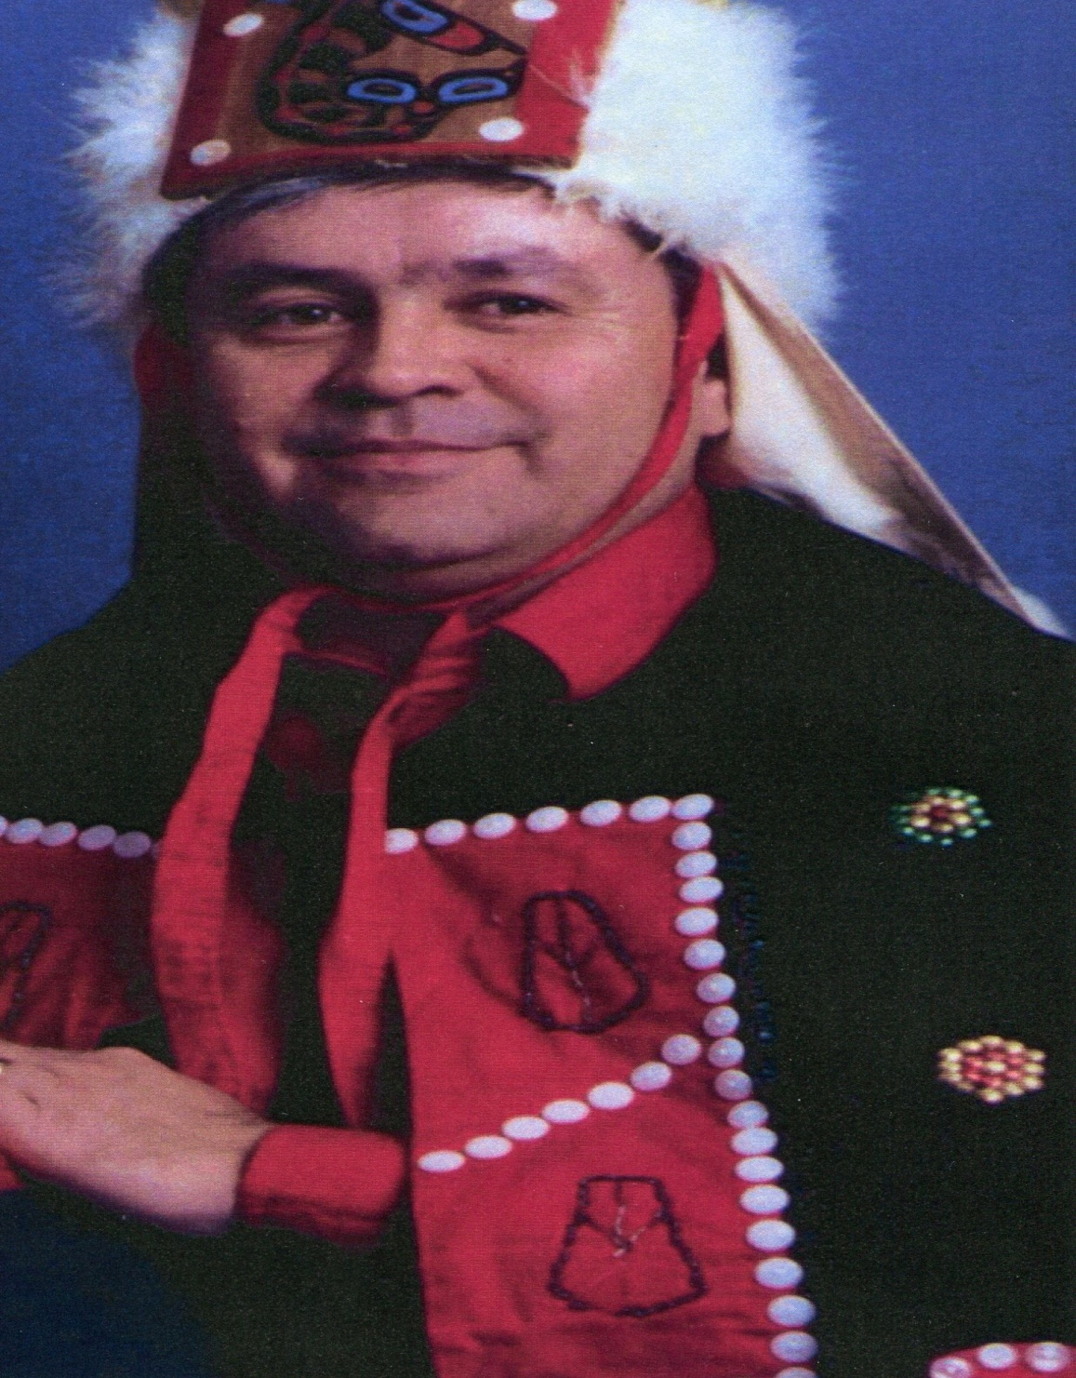
’Hím̓ás Lagáud du Hṃ̓zit Translation: Chief - Giving food Kenny Campbell Lílqvlaƛi - ’Wúyalitx̌v

Slide 12
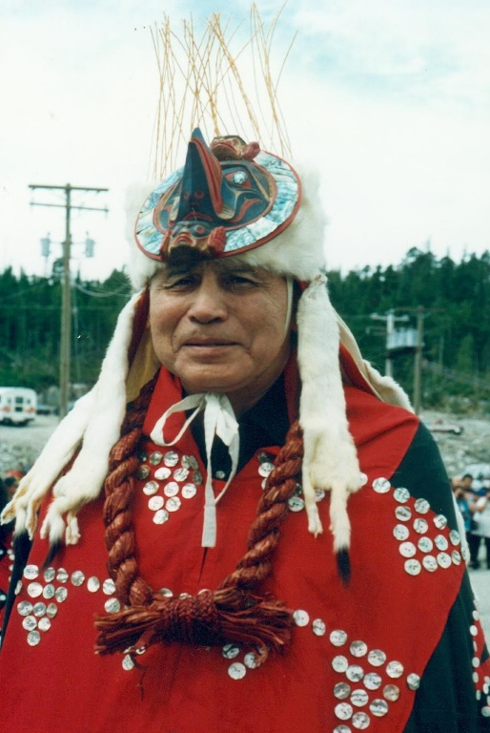
Chief: ’Hím̓ás Núlis Translation: Chief Ed Newman

Slide 13
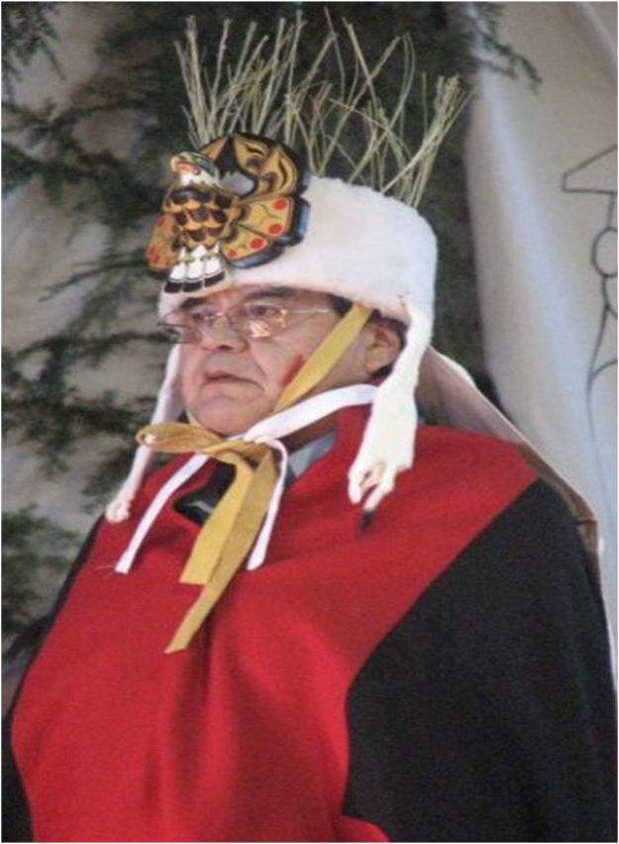
’Hím̓ás ’Qá’ait - Tlingit origin Translation: Chief - Having much wealth Arnold Humchitt Lílqvlaƛi - ’Qvúgvay̓aitx̌v

Slide 14
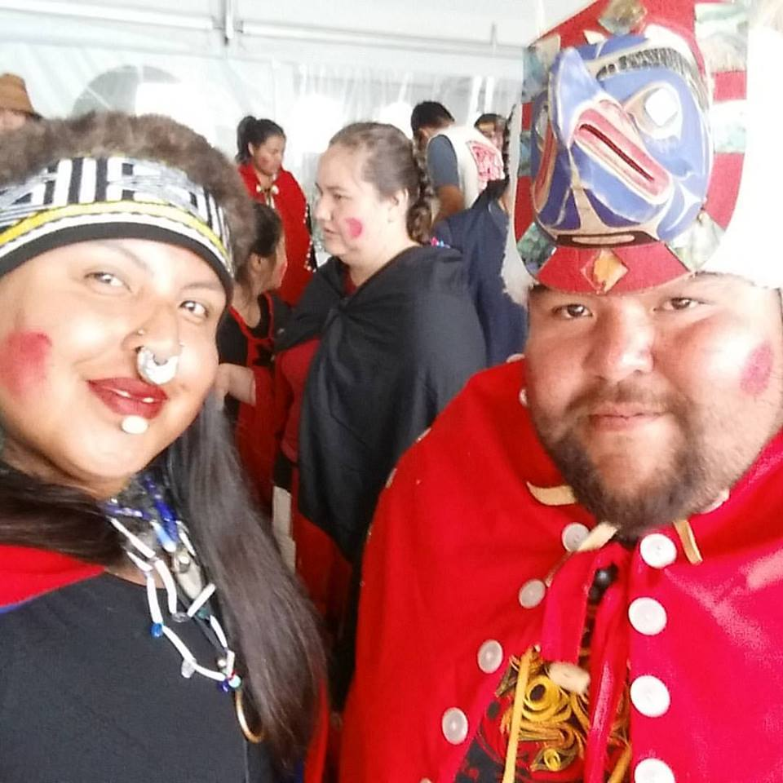
’Hím̓ás ’Máxvm̓visaǧṃi Translation: Chief - Always giving blankets Conrad Humchitt Lílqvlaƛi - ’Qvúgvay̓aitx̌v

Slide 15
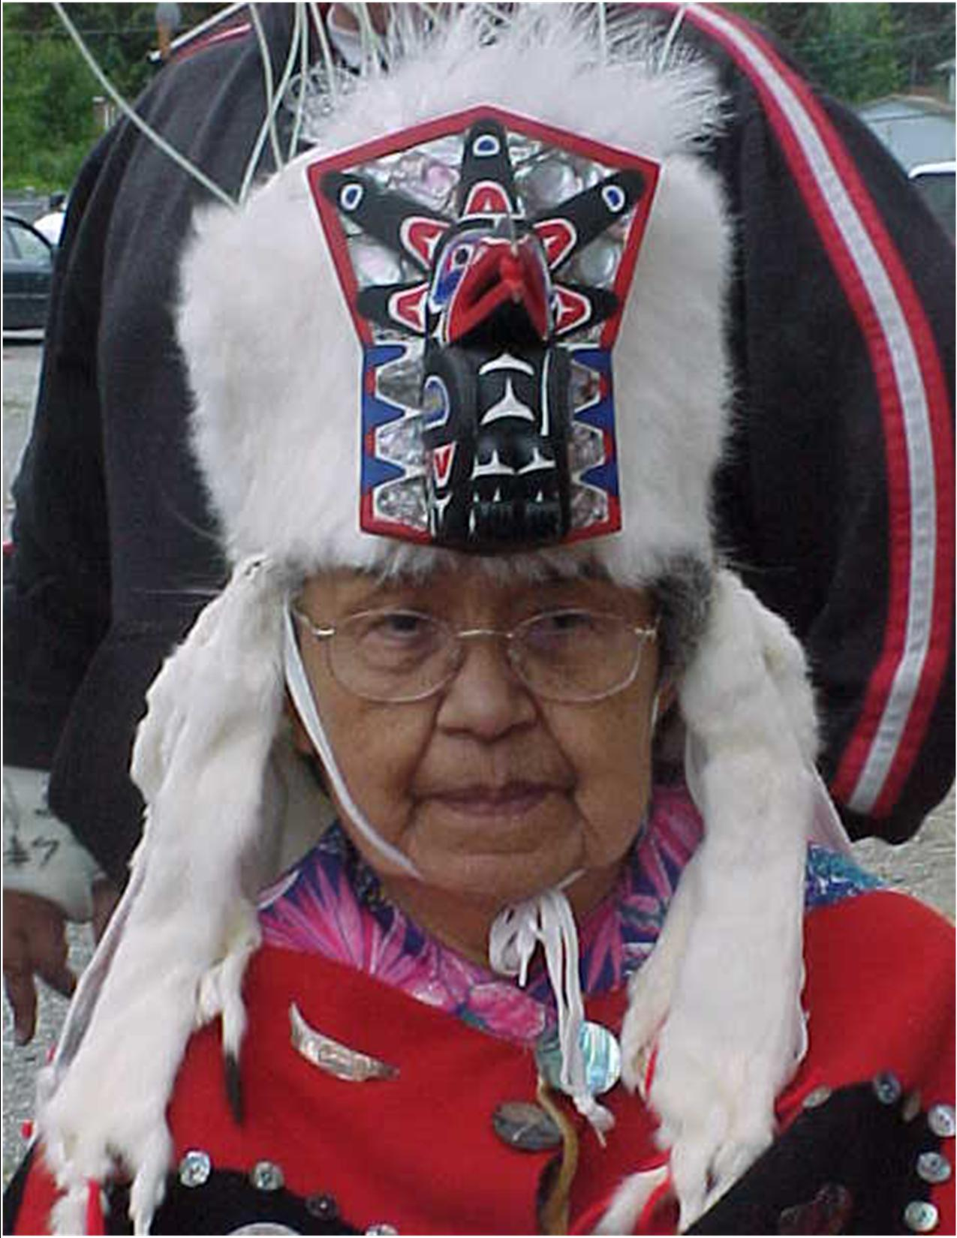
’Hím̓ás Wákas Translation: Chief - Great River Irene Brown Lílqvlaƛi - ’Qvúgvay̓aitx̌v

Slide 16
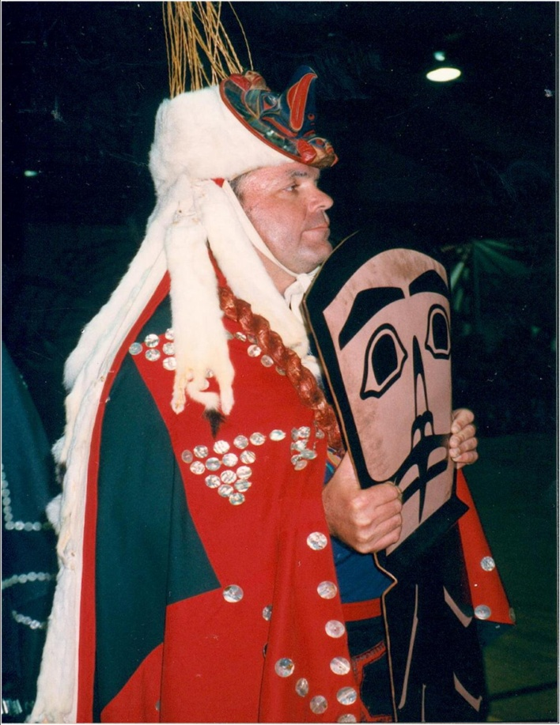
’Hím̓ás ƛípxsalagḷís Translation: Chief - Spreading wings throughout the world David Bell - Lílqvlaƛi - ’Qvúgvay̓aitx̌v

Slide 17
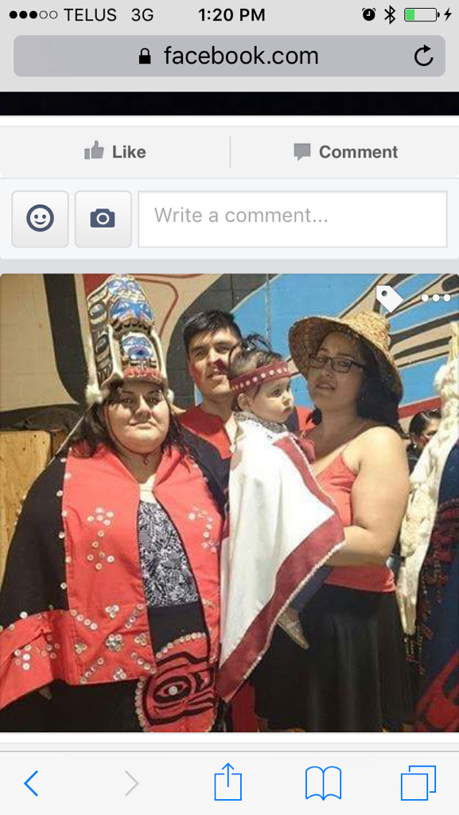
’Hím̓ás Qáqvaís Translation: Chief - Someone on the beach Crystal Woods Lílqvlaƛi - ’Qvúgvay̓aitx̌v

Slide 18
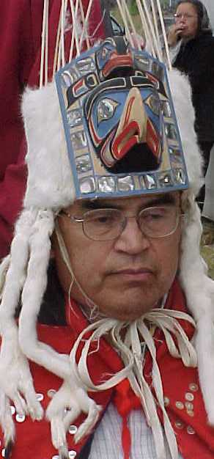
’Hím̓ás ’Qvúmán̓ukvḷa Translation: Chief - Getting rich Wilfred Humchitt Lílqvlaƛi - ’Wúiƛitix̌v

Slide 19
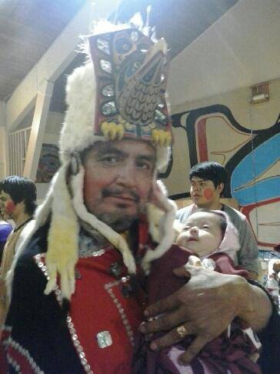
Chief: ’Hím̓ás ’Hṃ̓zit Translation: Chief - Giving food Garth Humchitt Lílqvlaƛi - ’Wúiƛitix̌v

Slide 20
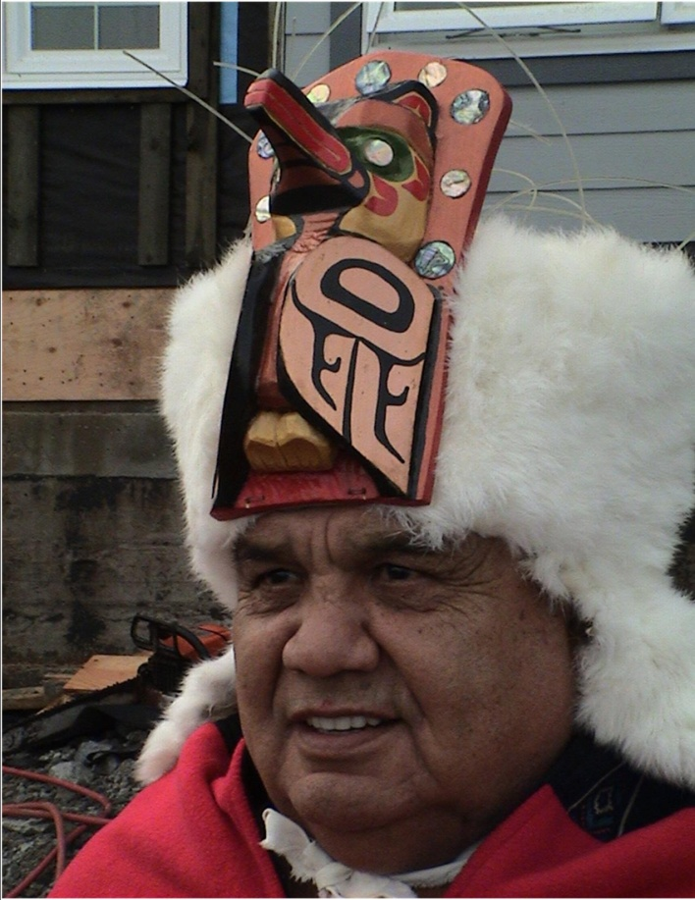
’Hím̓ás ’Tḷ̓tmxv Origin: Bella Coola Chief – translation of name unknown Mark White Lílqvlaƛi - ’Yísdáitx̌v

Slide 21
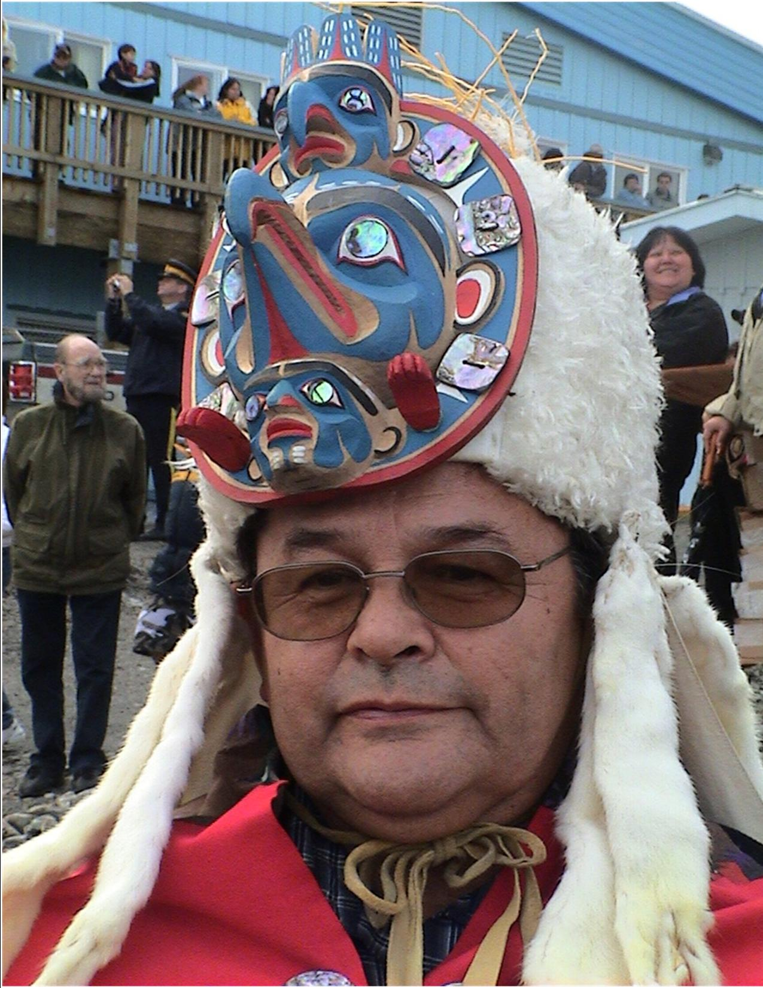
’Hím̓ás ’Nác̓i Translation: Wisdom place Chief Gary Housty Sr Lílqvlaƛi - ’Yísdáitx̌v

Slide 22
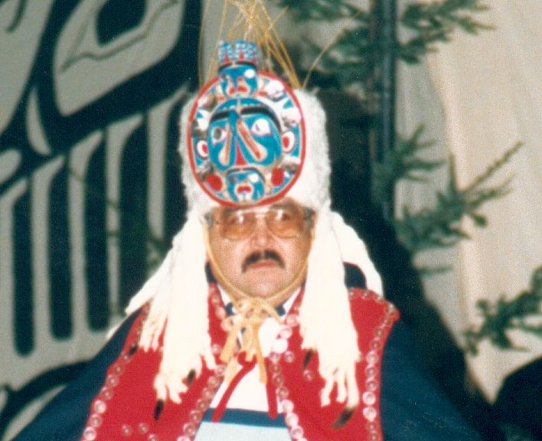
’Hím̓ás Yíṃ̓ázalas Translation: Chief throughout. Edward White Lílqvlaƛi - ’Yísdáitx̌v

Slide 23
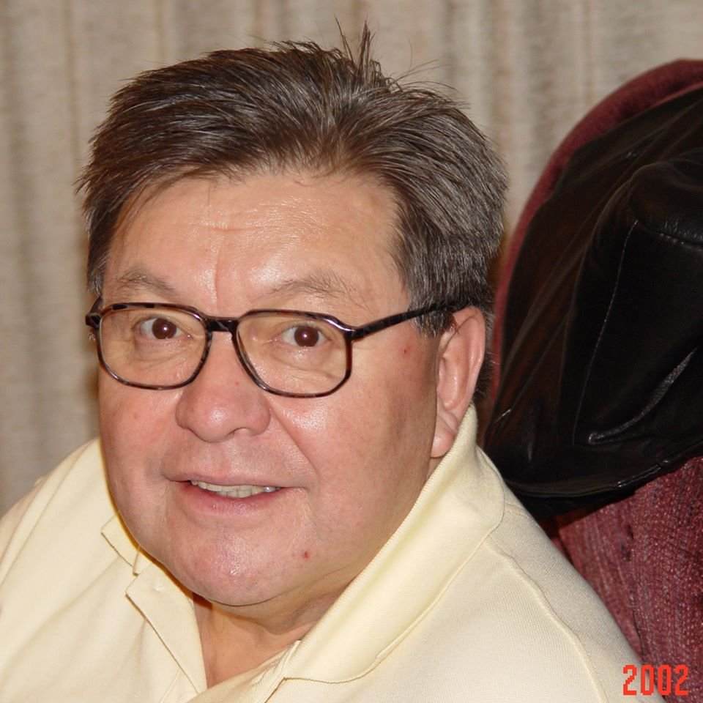
’Hím̓ás ’Qvúmúkvia Translation: Chief - Sea Monster over there Chester Lawson Lílqvlaƛi - ’Yísdáitx̌v

Slide 24
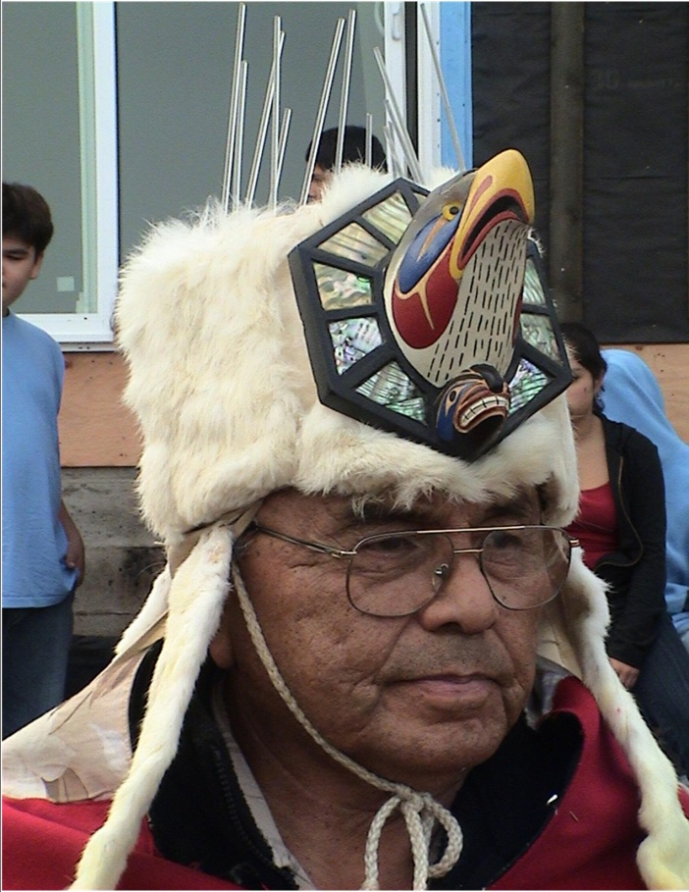
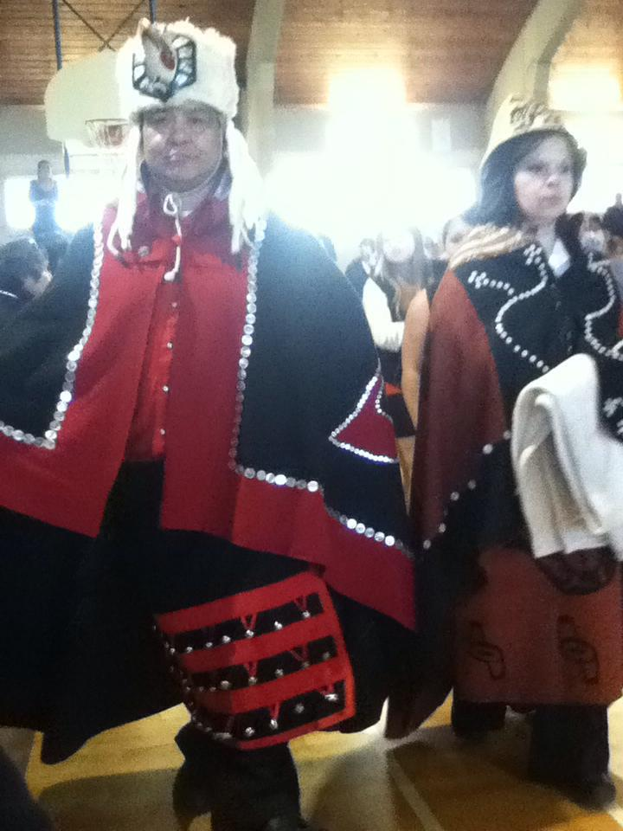
’Hím̓ás Laqvmís Translation : Chief - Traveling to potlatches and staying places. Johnny Moody Jr. Lílqvlaƛi - X̌áix̌ais

Slide 25
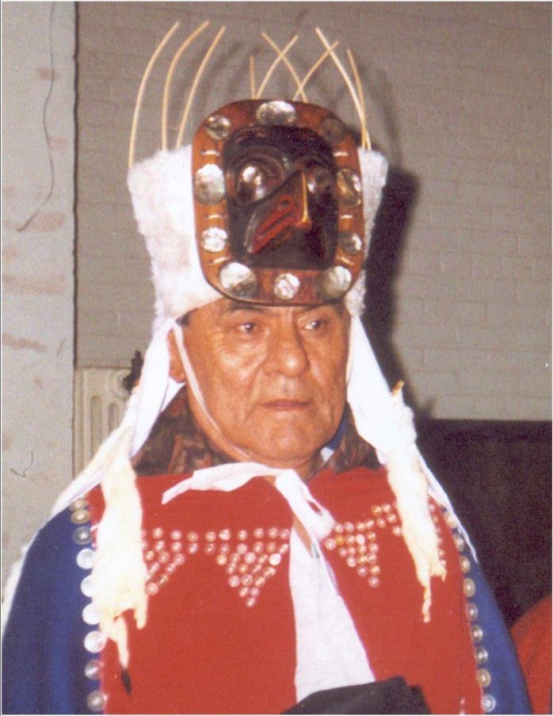
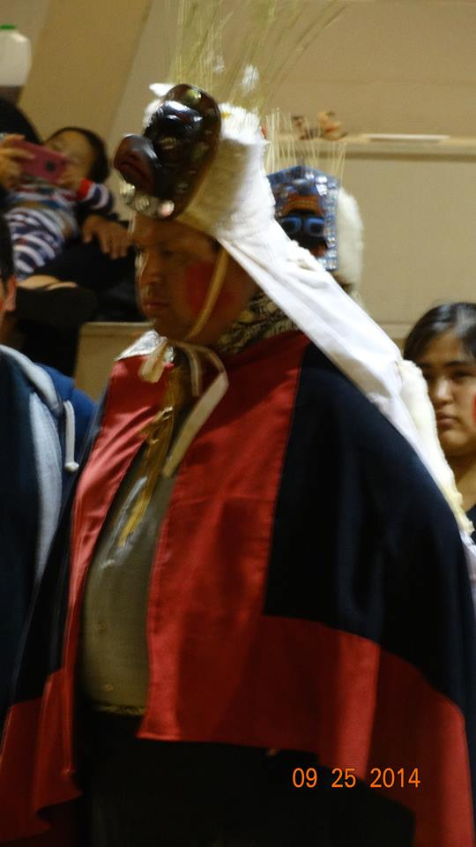
’Hím̓ás Gálǧṃax̌ais Translation : Chief - First to descend from the heavens. Dennis Humchitt Lílqvḷaƛi - X̌áix̌ais

Slide 26
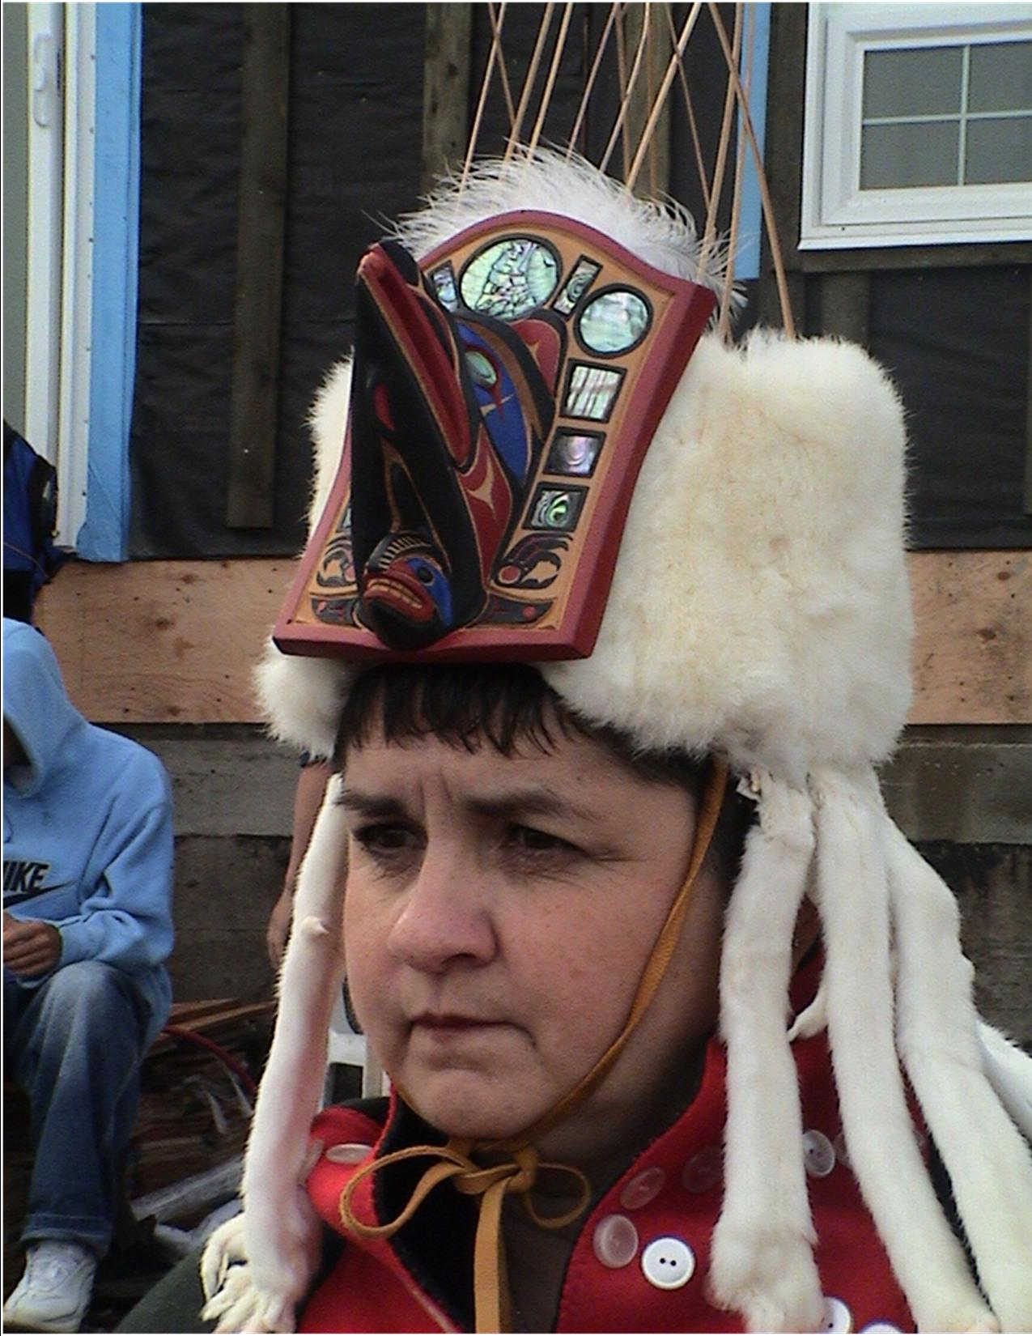
’Hím̓ás Gḷ́tmaiɫ Translation: Chief - Long life. Tina Elluk. Lílqvḷaƛi - X̌áix̌ais

Slide 27
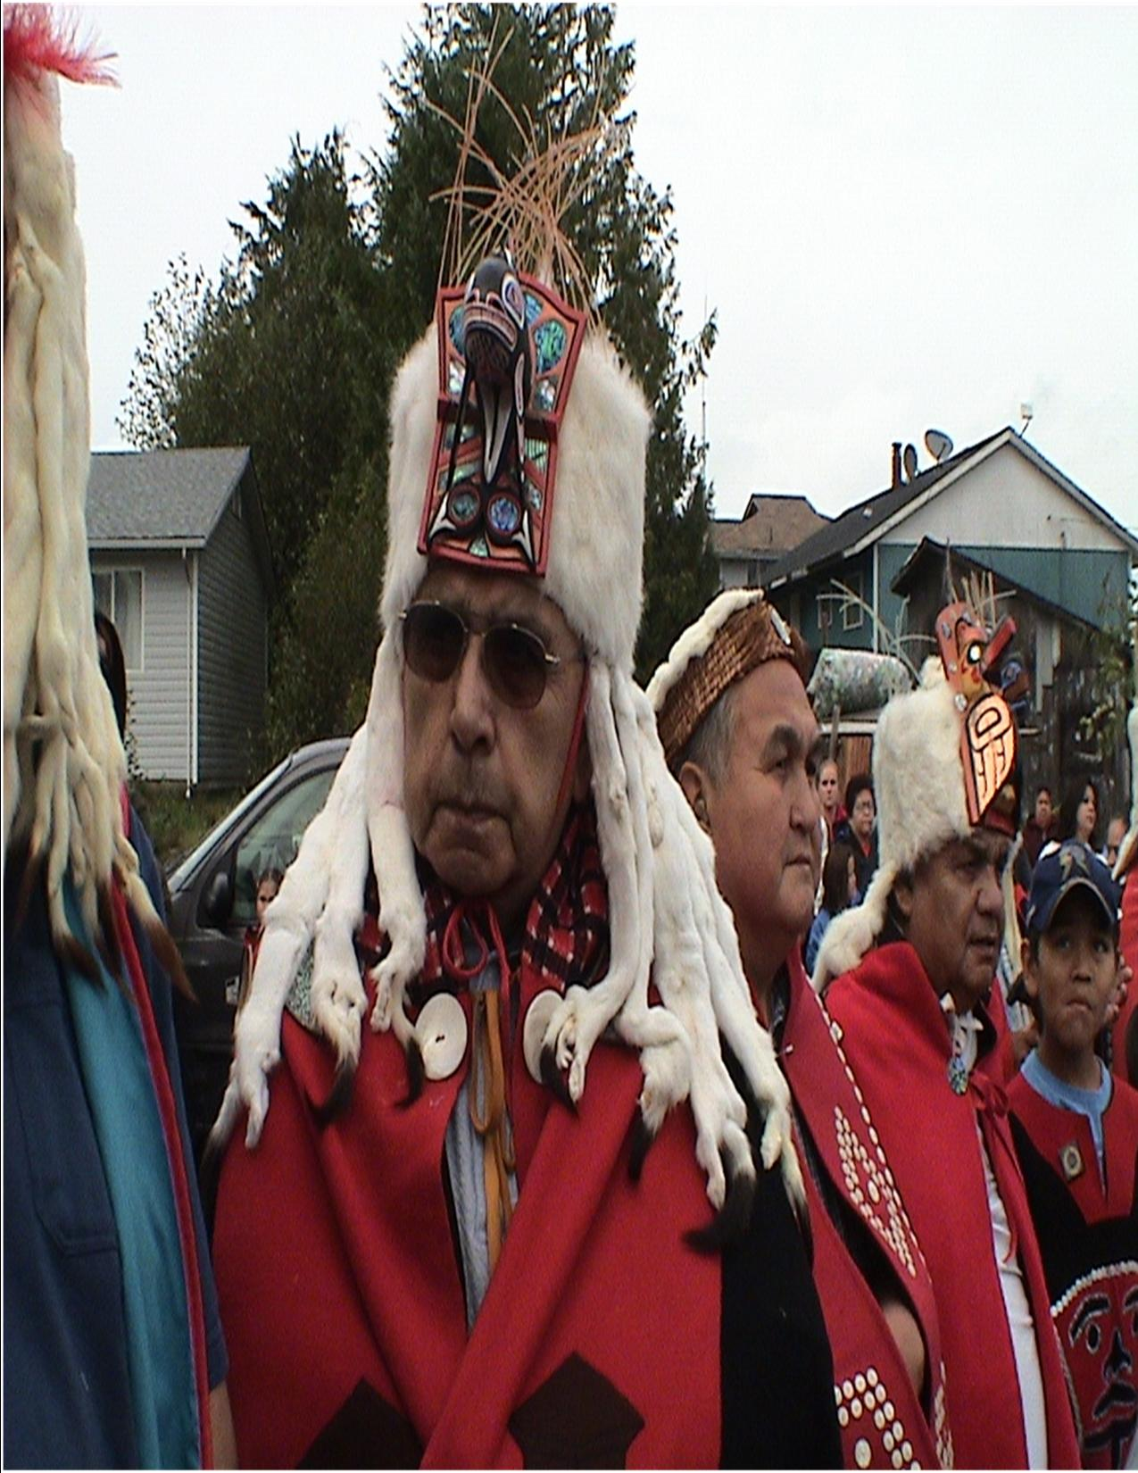
’Hím̓ás Wík̓vaṇat Translation: Chief – and his name refers to eagle attire Peter Mason Lílqvḷaƛi - X̌áix̌ais

Slide 28
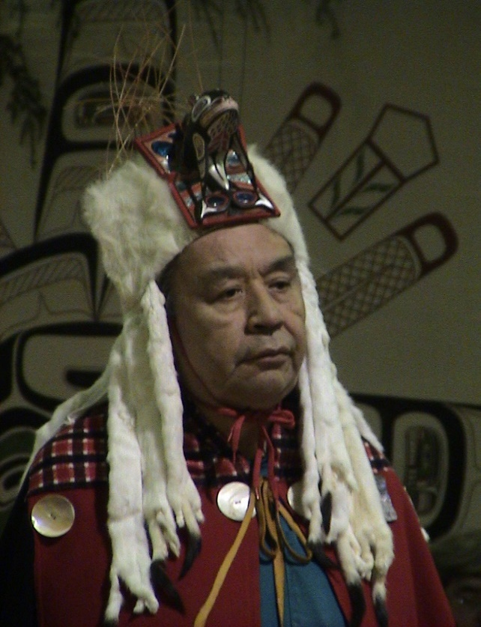

’Hím̓ás’Qvṃ́gílakv Translation: Chief -someone who stands out Paul Thompson Lílqvḷaƛi - ’Wuík̓inux̌v

Slide 29
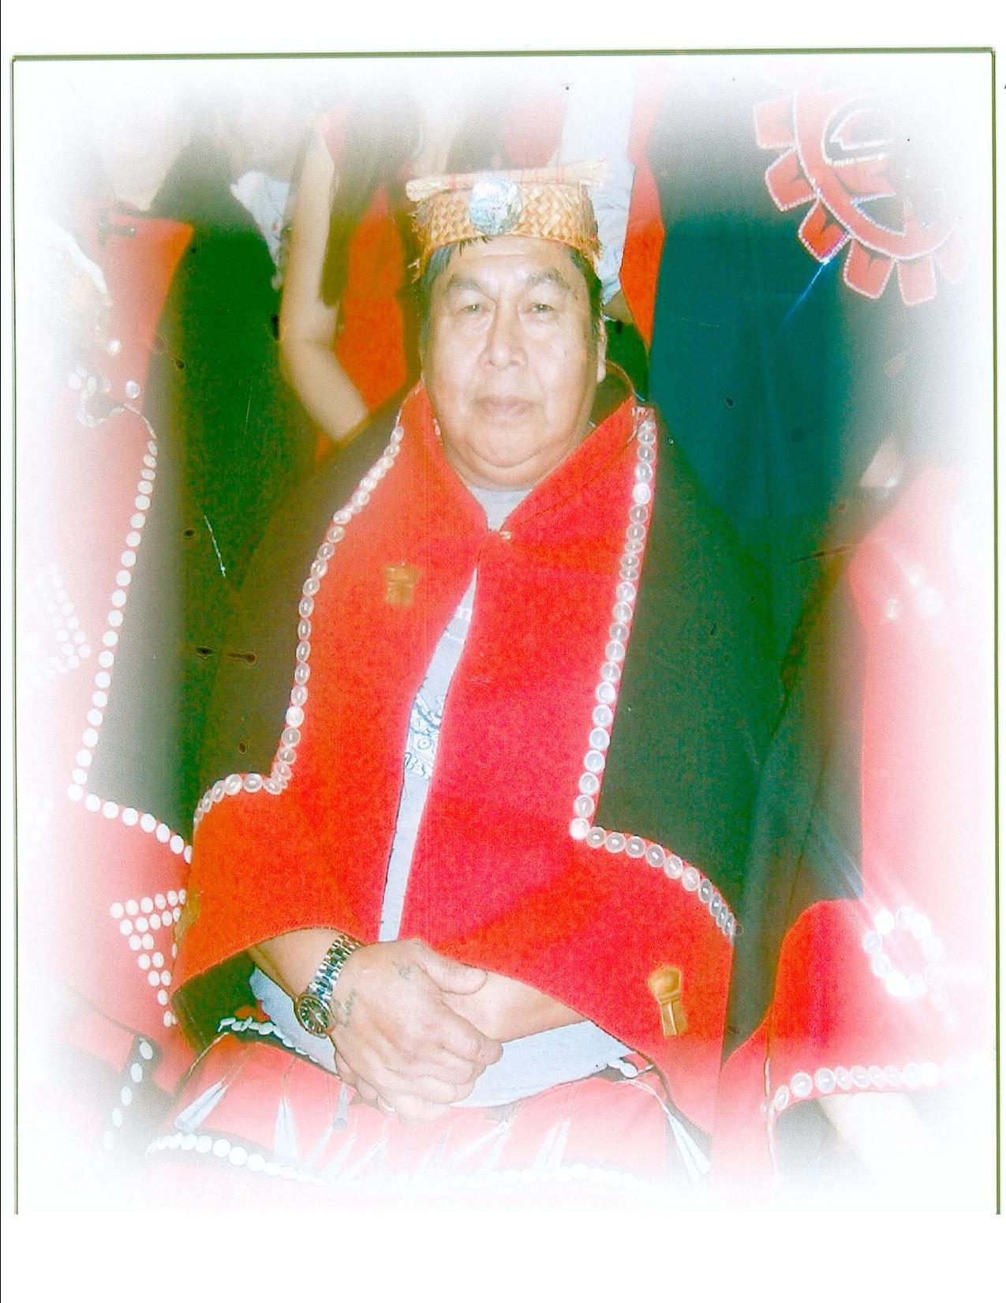
’Hím̓ás Múdaná Translation Chief, name translation unknown Ralph Chamberlain Lílqvḷaƛi - ’Wuík̓inux̌v

Slide 30
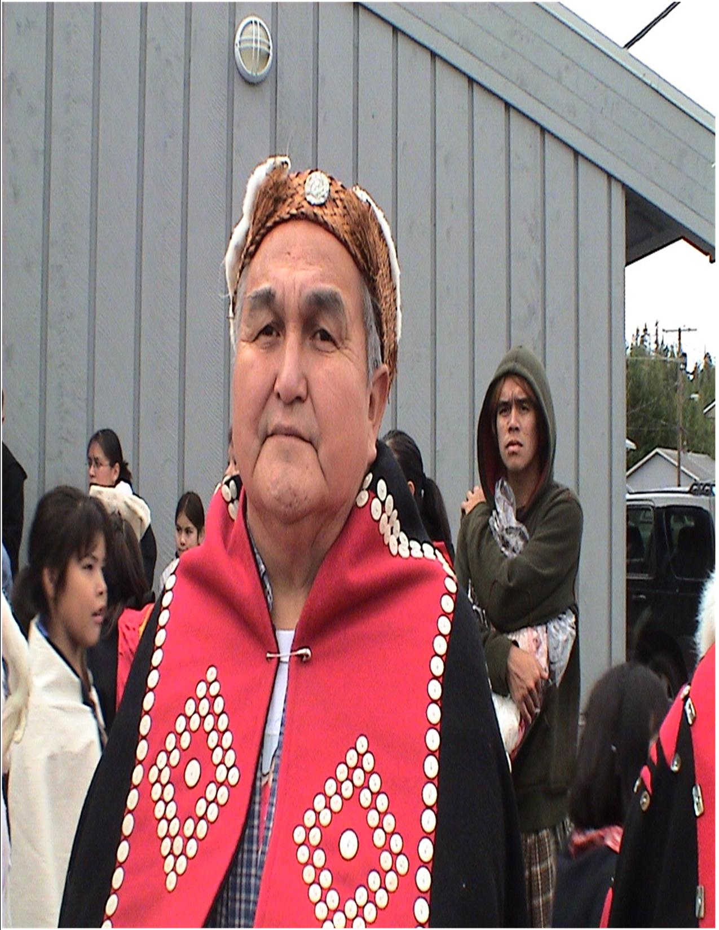
’Hím̓ás ƛ̓áɫúsḷa Translation: Chief - surveying out of a bay Charlie Lawson Lílqvḷaƛi - ’Wuík̓inux̌v

Slide 31
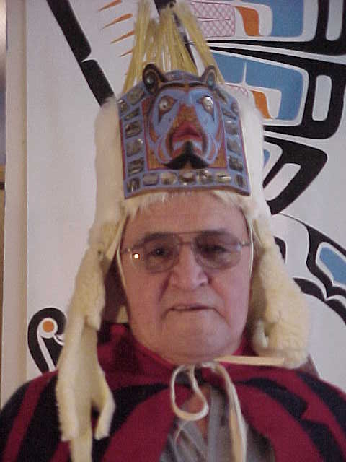
’Hím̓ás Gáyustis
Translation: Chief - Place of coming out
Gilbert Jackson
Lílqvḷaƛi - ’Wuík̓inux̌v

Slide 32
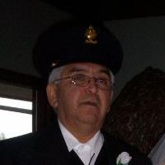
’Hím̓ás Lagaíx: Translation: - Chief, name translation unknown Stephen Hunt Sr. Lílqvḷaƛi - ’Wuík̓inux̌v

Slide 33
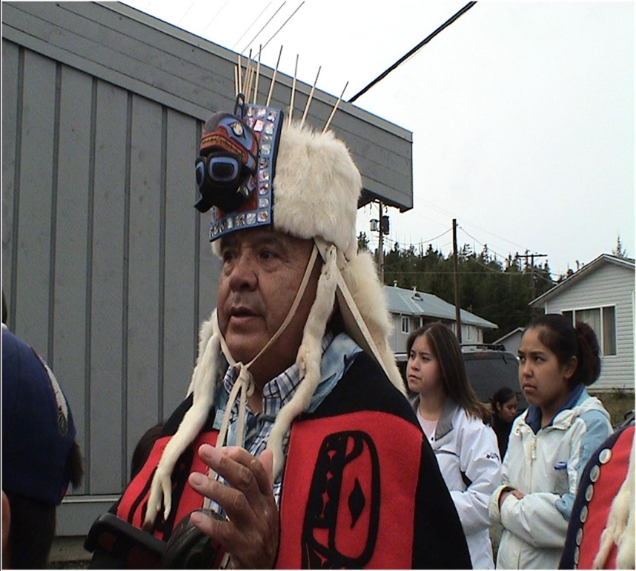
’Hím̓ás ’Wúmakn Translation: Chief - Endured personal father Mel Innes Lílqvḷaƛi - X̌a̓ísḷá

